Slide 1
Predictive Maintenance of Industrial Machinery
IBM SkillsBuild Project
Presented By:
Janvi Agarwal – University Institute Of Engineering And Technology, Kurukshetra

Slide 2
OUTLINE
Problem Statement
Proposed System/Solution
System Development Approach
Algorithm & Deployment
Result
Conclusion
Future Scope
References

Slide 3
Problem Statement
Develop a predictive maintenance model for a fleet of industrial machines to anticipate failures before they occur. This project will involve analyzing sensor data from machinery to identify patterns that precede a failure. The goal is to create a classification model that can predict the type of failure (e.g., tool wear, heat dissipation, power failure) based on real-time operational data. This will enable proactive maintenance, reducing downtime and operational costs.

Slide 4
Proposed Solution
The proposed system focuses on the classification of different fault types in a power distribution network using machine learning techniques. The solution involves the collection of electrical measurement data, specifically voltage and current phasors, under both normal and faulty operating conditions. This raw data is then preprocessed to handle missing values, normalize ranges, and prepare it for training.
The solution will consist of the following components:
DATA COLLECTION: Used the Kaggle dataset of Machine Predictive Maintenance Classification.
PRE PROCESSING: Cleaned and by normalizing the dataset.
MODEL TRAINING: Trained a classification model (i.e. Decision Tree, Random Forest and SVM).
EVALUATION: Validated the model using Accuracy, Precision, recall and F1 Score.

Slide 5
System Approach
Technologies Used:
Python (IBM Watsonx.ai Notebooks)
IBM Cloud Object Storage
Machine Learning Libraries: pandas, matplotlib
Dataset: Phasor-based voltage and current values with fault labels
System Requirements:
IBM Cloud
Watsonx.ai Studio for model development and deployment.
Clean CSV data with labelled fault types
IBM WATSONX RUNTIME SERVICE to build, Deploy, Manage, Optimize decision anywhere.
IBM cloud object storage for dataset handling.

Slide 6
Algorithm & Deployment
Algorithm Selection:
Random Forest Classifier, Decision Tree Classifier (or SVM based on performance).
Data Input:
UDI, Product ID, Type, Air temperature[K], Process temperature[K], Rotational speed[rpm], Torque[Nm], Tool wear[min], Target.
Training Process:
Supervised learning using labeled sensor data to classify fault types in industrial machines.
Prediction Process:
Model deployed on IBM Watson Studio with API endpoint for real-time predictions.

Slide 7
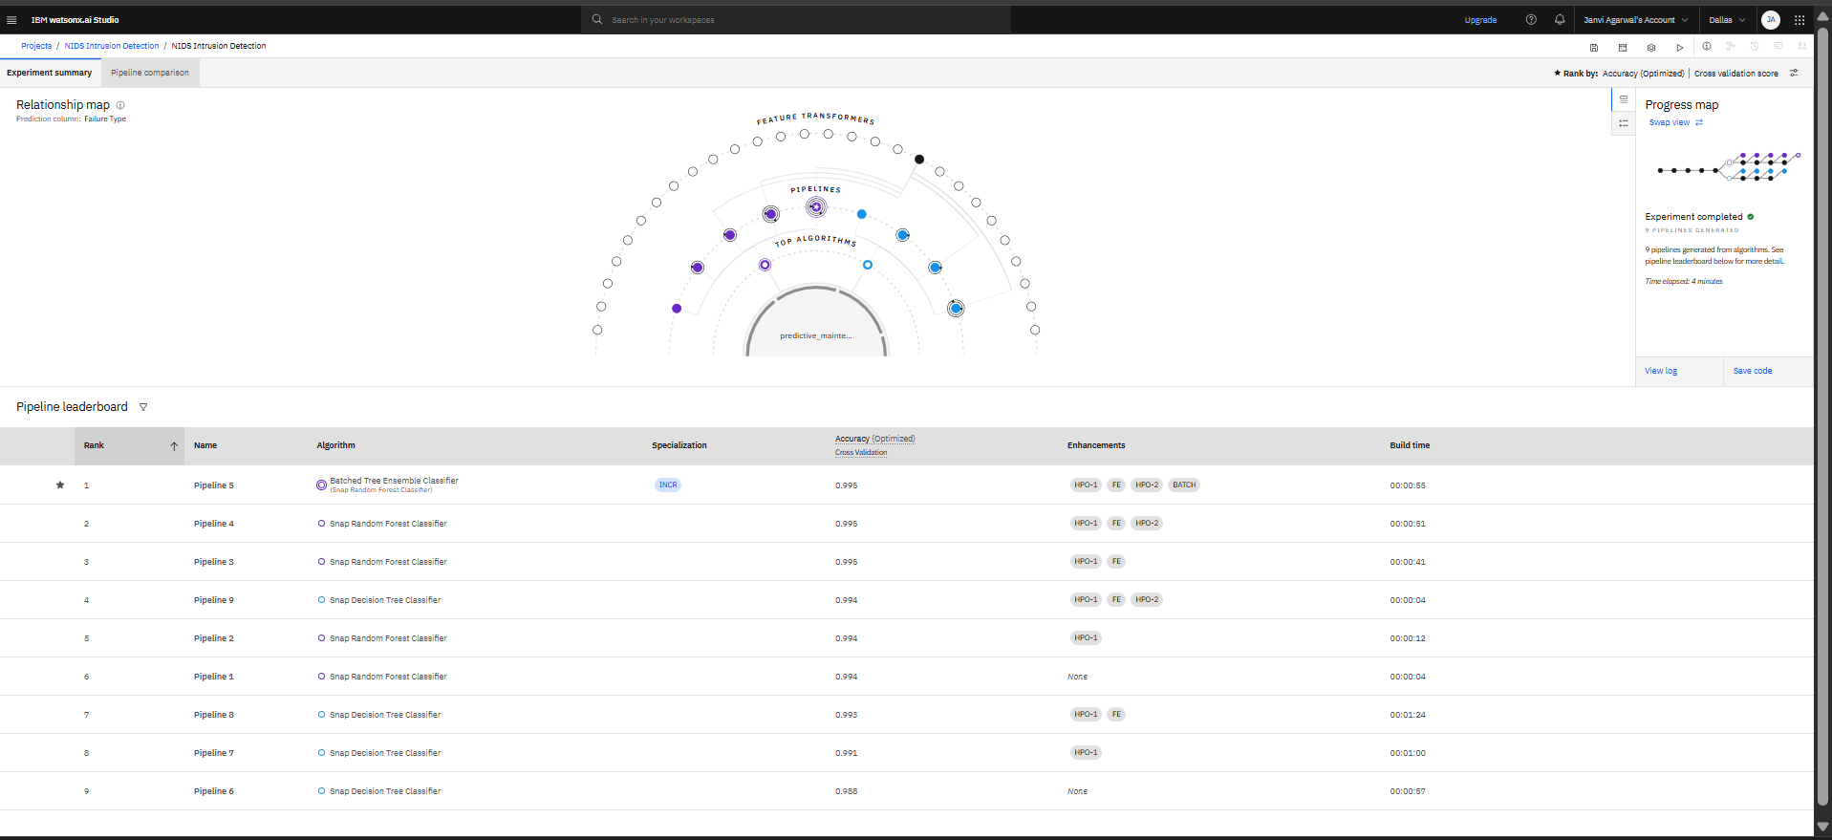
Result

Slide 8
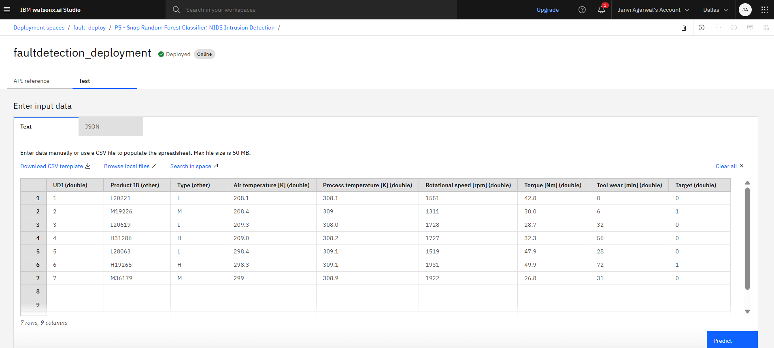
Result

Slide 9
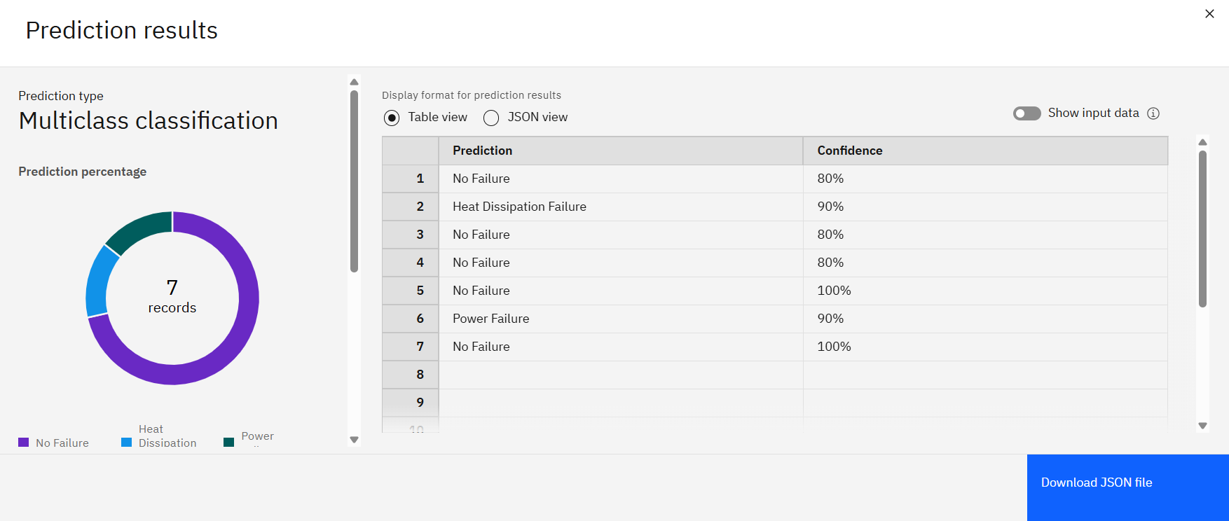
Result

Slide 10
Conclusion
The machine learning-based fault classification model successfully identified and distinguished between various fault types, including heat dissipation failure, power failure, and no failure conditions.
IBM Watsonx.ai AutoAI efficiently automated the model training process, selecting the best-performing algorithm with 99.5% accuracy, ensuring high reliability.
The deployed model responded accurately to real-time input data with confidence levels reaching 100%, demonstrating its potential for use in industrial or power monitoring applications.
The overall system proves that integrating AI with real-world sensor data can lead to fast, scalable, and precise fault detection — essential for maintaining stability in power or manufacturing environments.

Slide 11
Future scope
To improve the accuracy, scalability, and real-time responsiveness of the Predictive Maintenance Classification System, several enhancements and future directions can be explored:
Environmental Data: Integrate external data such as humidity, ambient temperature, or vibration from nearby machinery to capture indirect failure causes.
Operator Logs: Use human-generated logs or maintenance notes to correlate observed behavior with actual faults.
Machine Usage History: Incorporate operational context like usage intensity, shift timings, or historical fault patterns for deeper insight

Slide 12
References
Kaggle dataset for machine predictive maintenance classification:-https://www.kaggle.com/datasets/shivamb/machine-predictive-maintenance-classification.

Slide 13
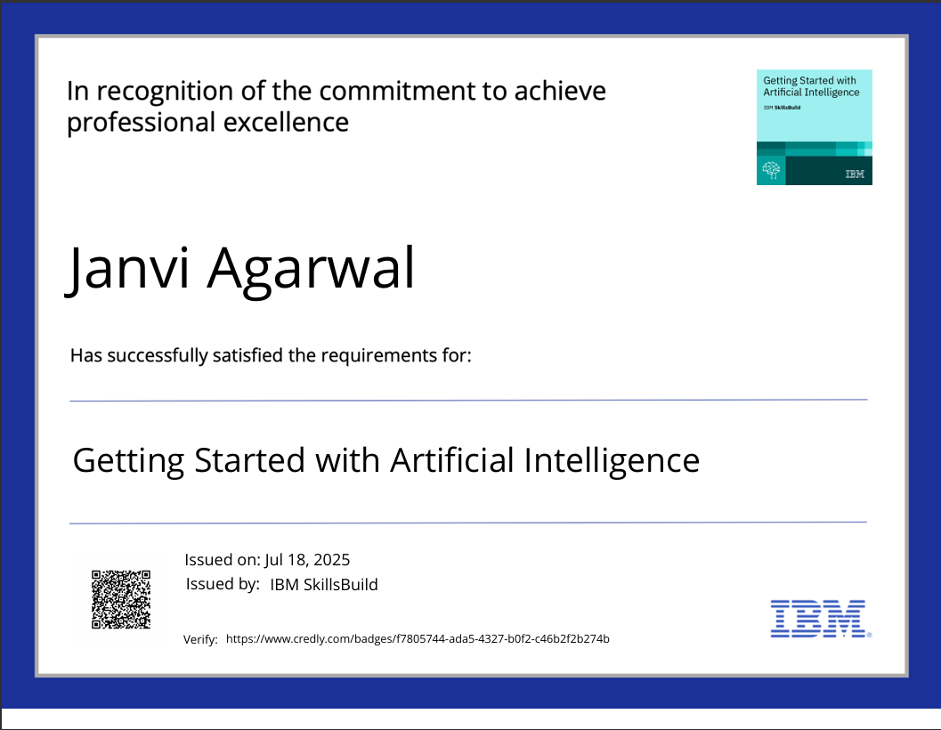
IBM Certifications

Slide 14
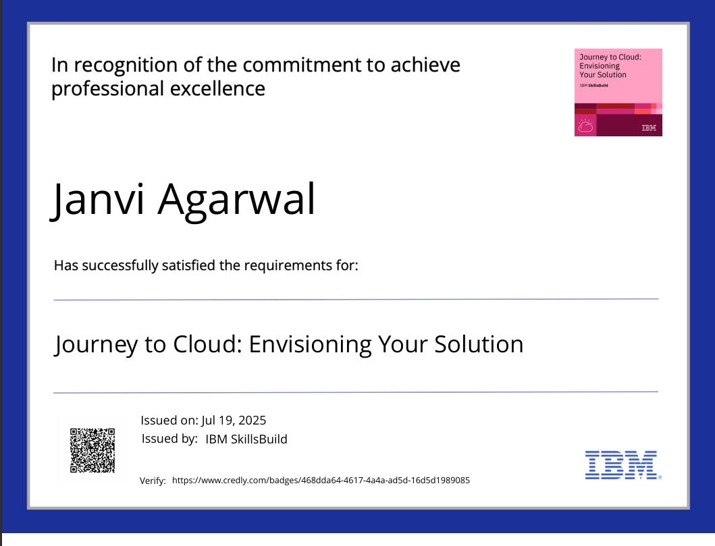
IBM Certifications

Slide 15
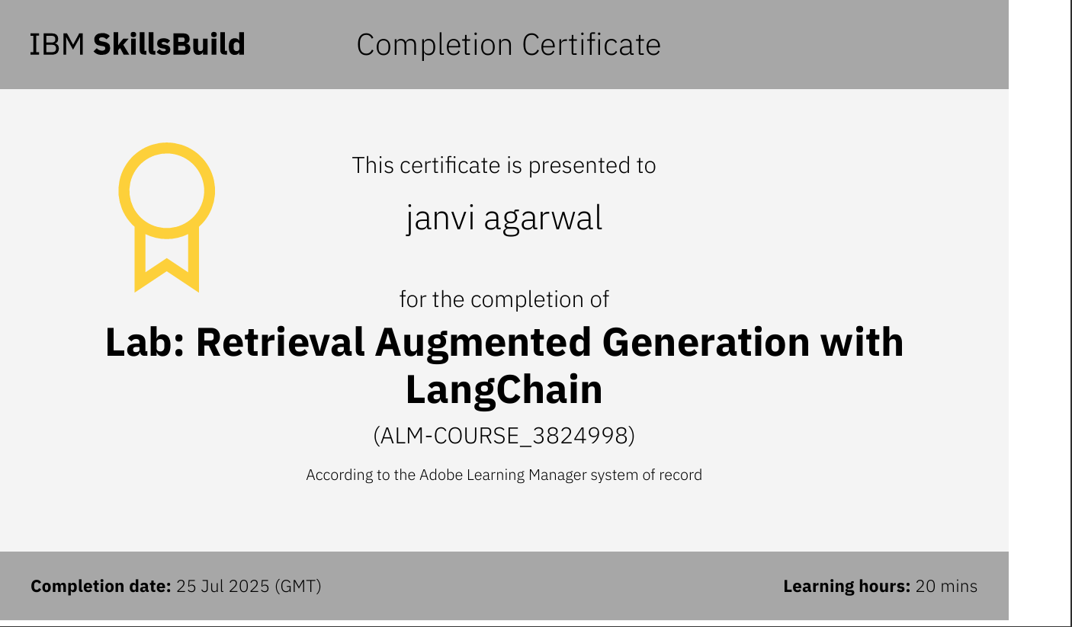
IBM Certifications

Slide 16
Github link
https://github.com/janviagarwal28/IBM-cloud-project

Slide 17
THANK YOU

